Slide 2
Introduction to Pathway Modeling
October 25, 2019

Slide 3
Goals and Motivations
Review how pathways are used in research
Discover the advantages to computational pathway models
Access existing pathway tools
Learn how to use pathway drawing tools
Create your own pathway models!

Slide 4
Overview
Introduction to Pathways in Research
Guided Tour of Editing Tools
Quality Control for WikiPathways
Hands-on Session 1: Introduction
Break
Hands-on Session 2: Create Your Own Pathway

Slide 5
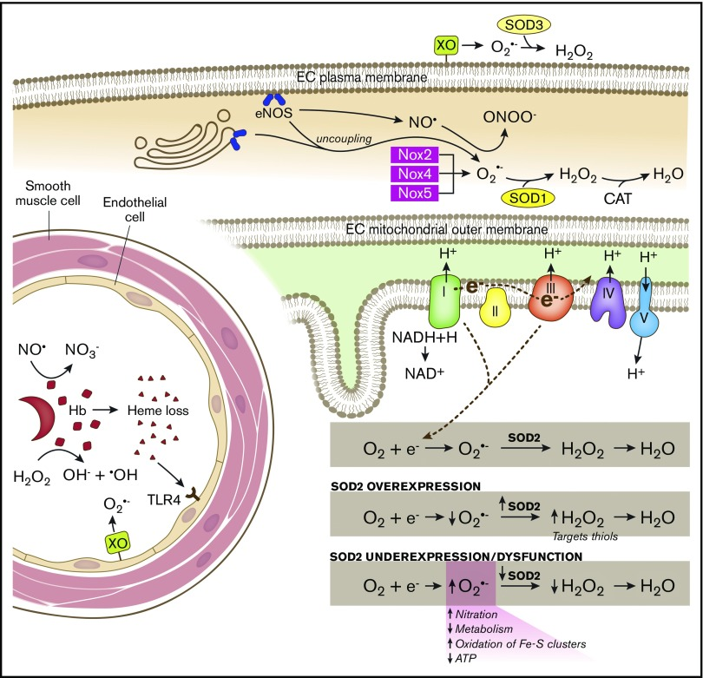
Why Pathways?
Intuitive representation of complex information
è Over 1000 published each month
Proteins / genes / metabolites
Interactions / reactions
Subcellular location
Dosunmu-Ogunbi et al, Blood Advances, 2019

Slide 6
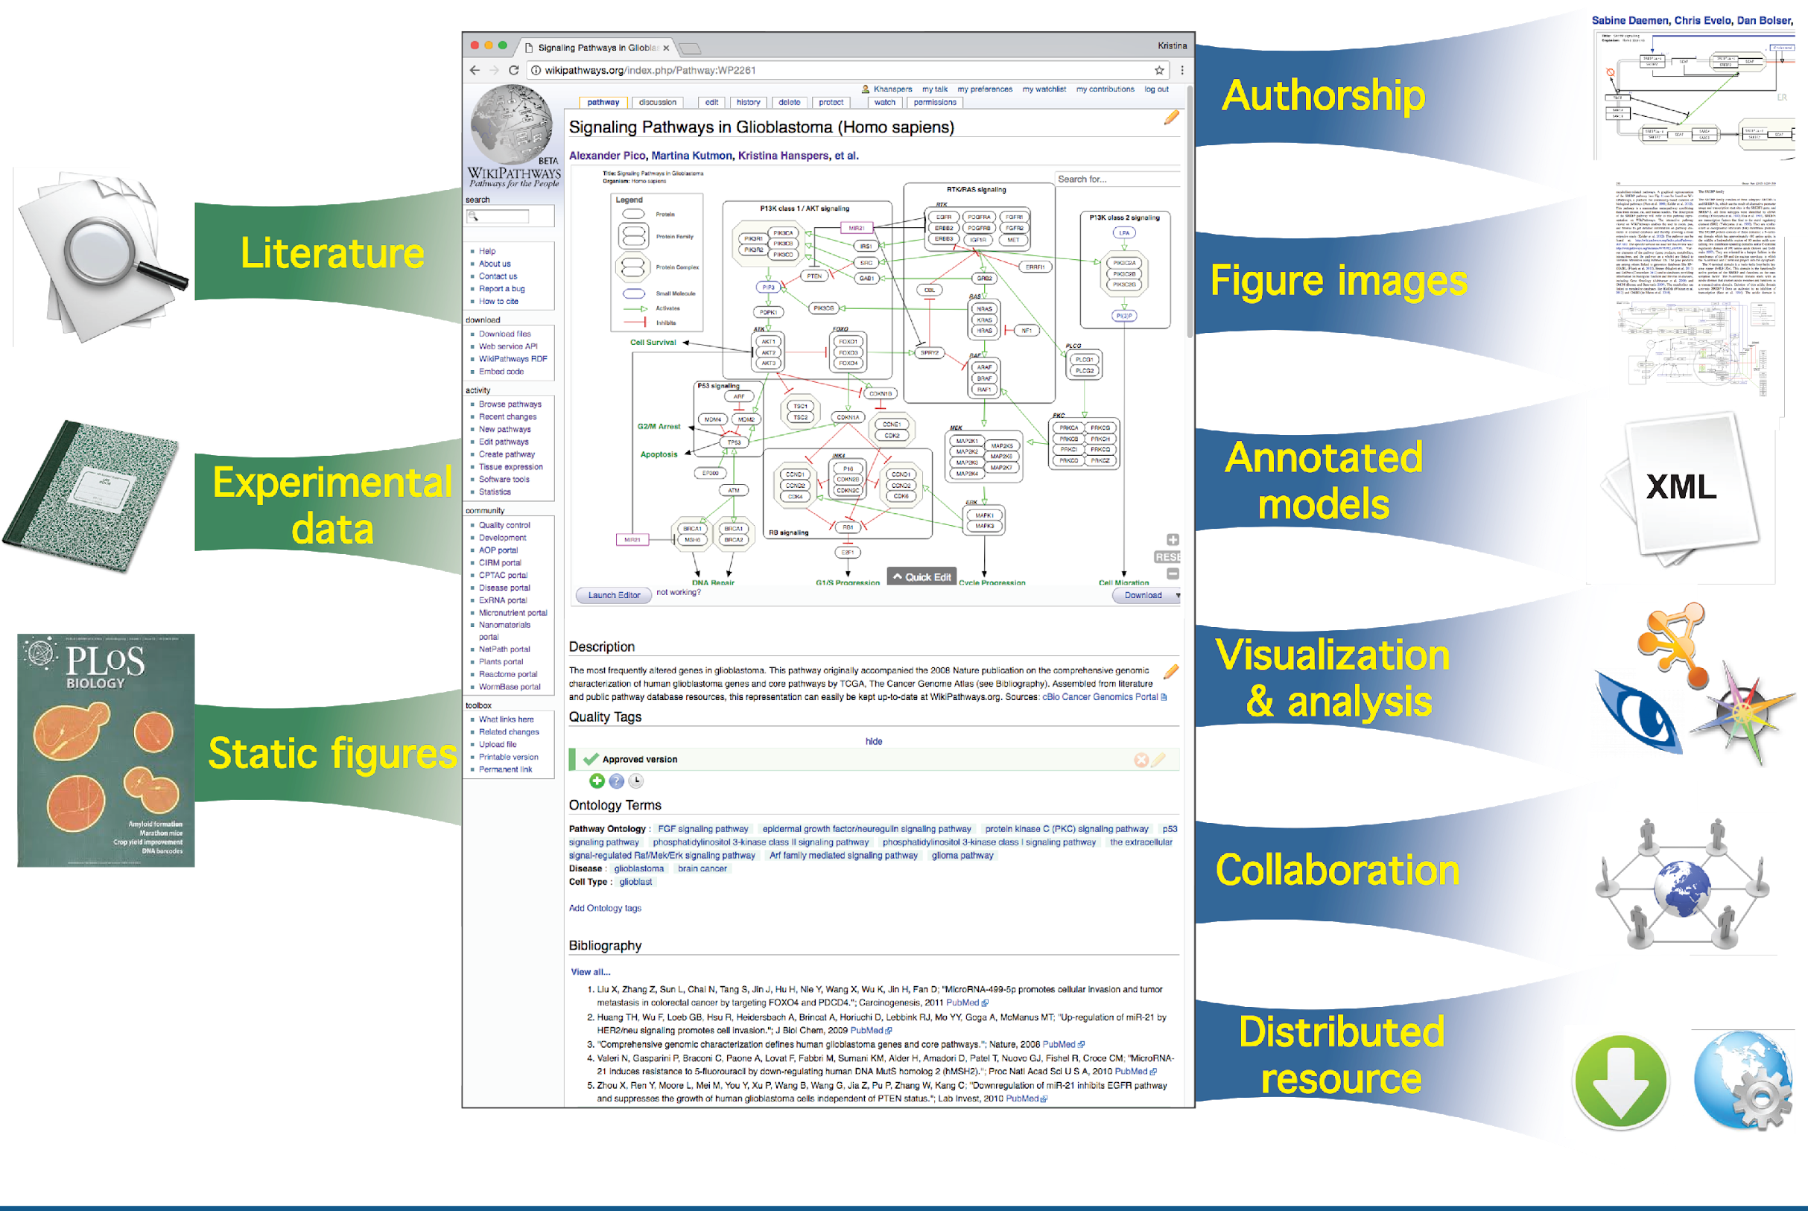
Why Pathway Models?

Slide 7
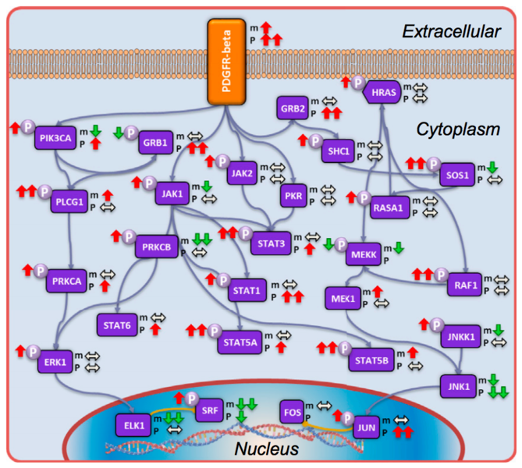
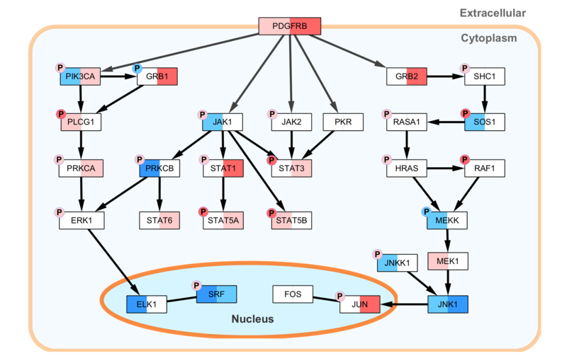
Data Visualization on Pathway Models
Static image
Zhang et al, Cell 2016
PDGFR-beta pathway with transcriptomic/phosphoproteomic data
Zhang et al, Cell 2016

Slide 8
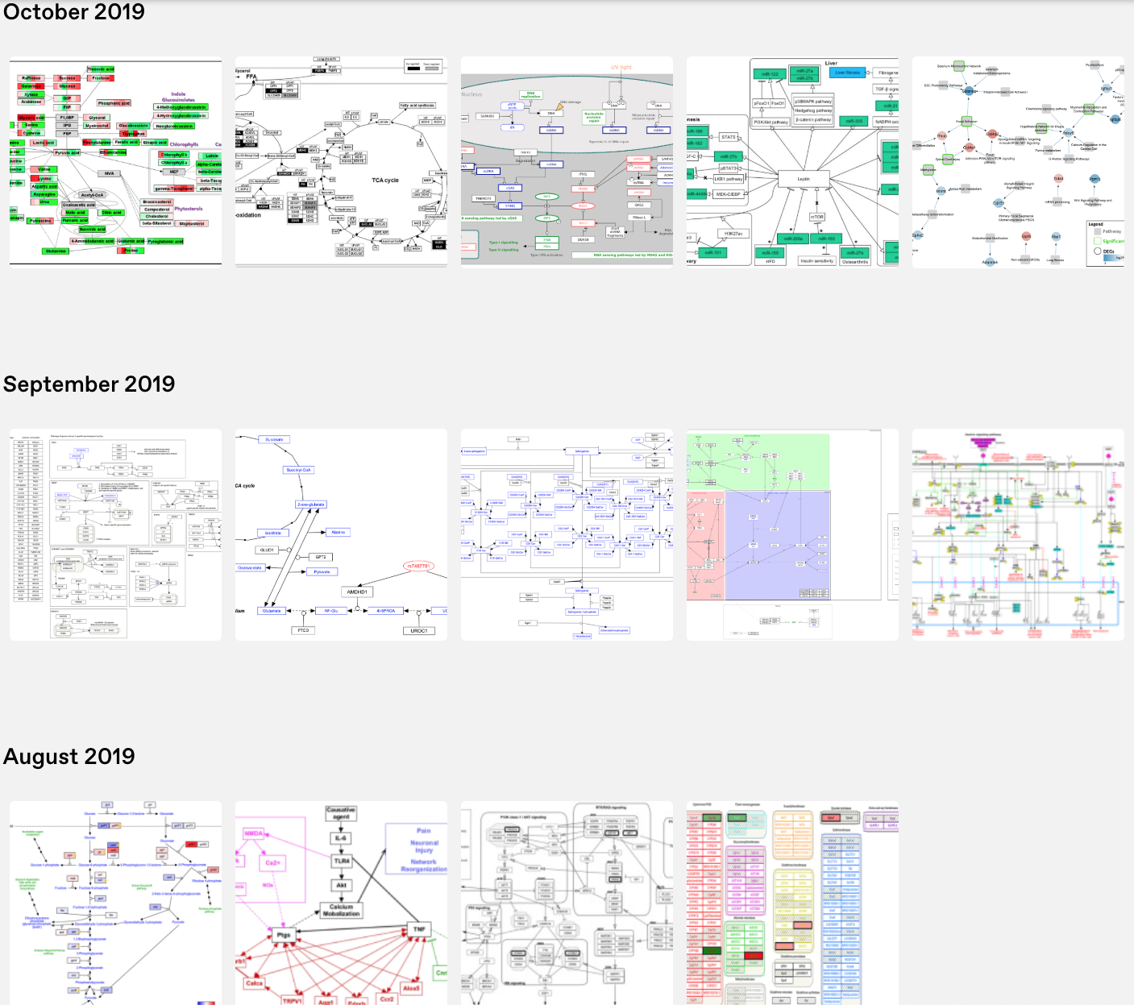

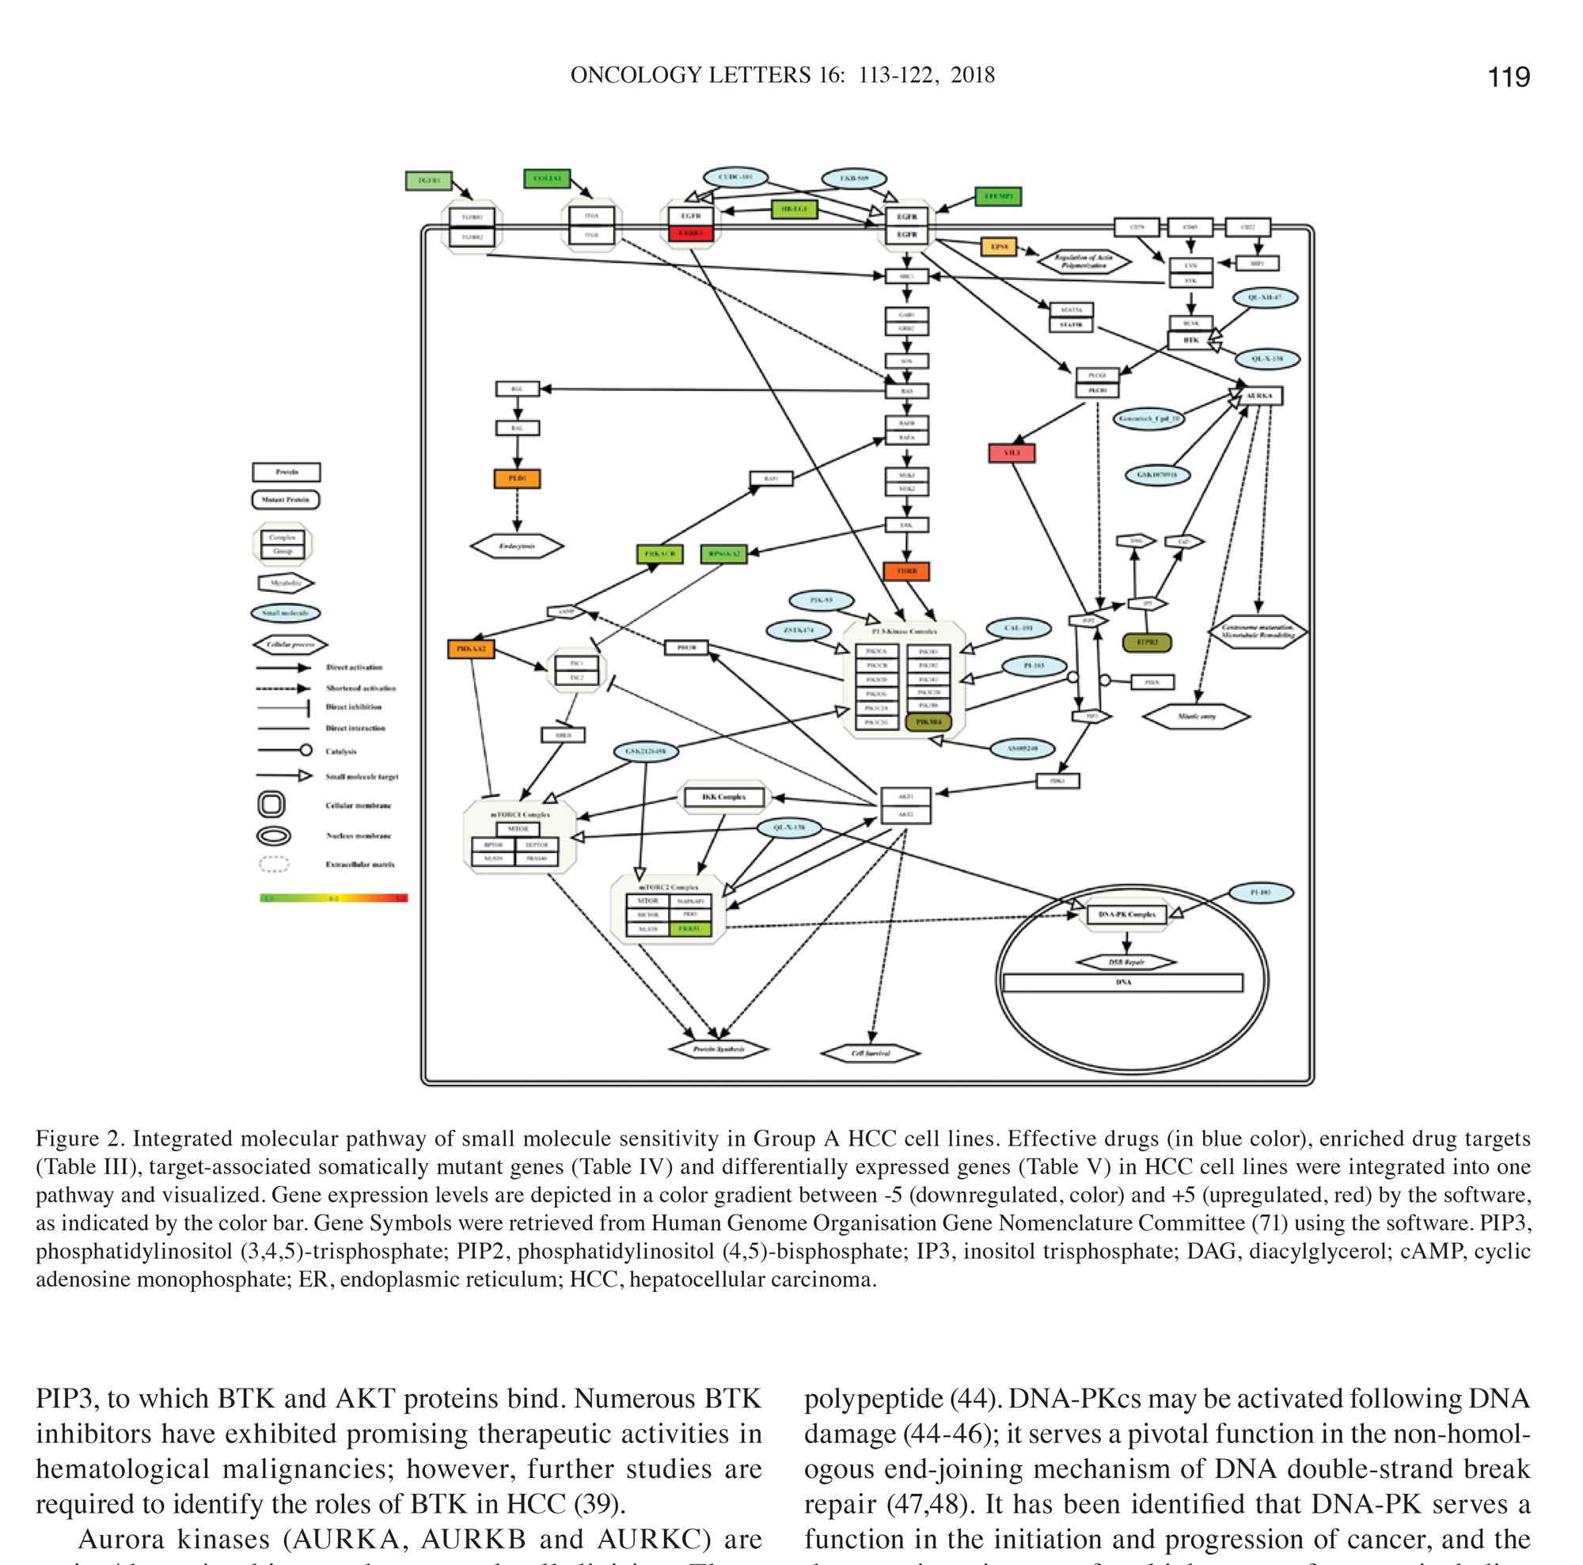
Publishing Pathway Models
http://wikipathways.tumblr.com/
Gokhan Yildiz, Oncol Lett. 2018

Slide 9
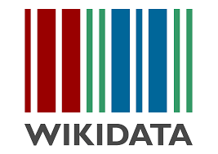
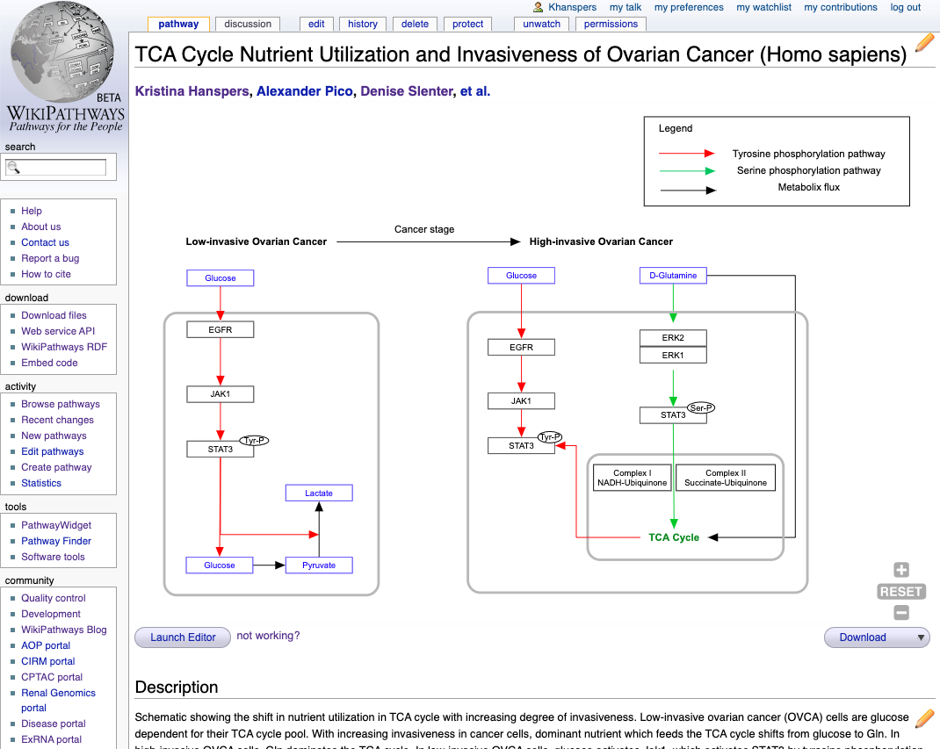
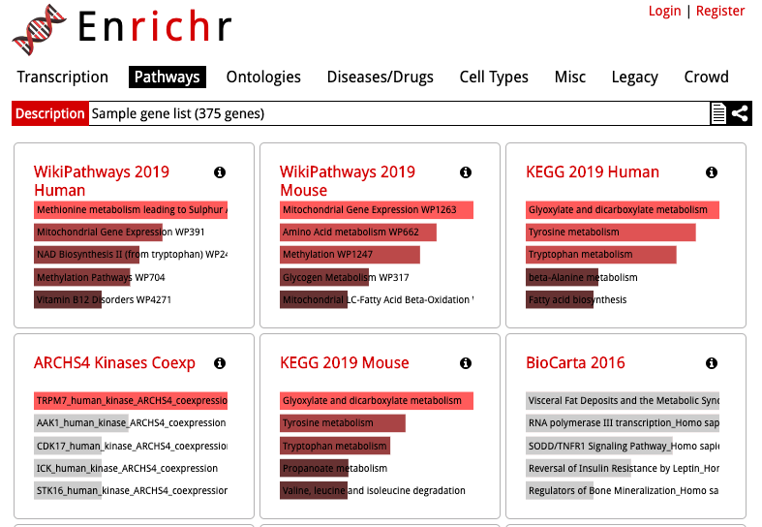
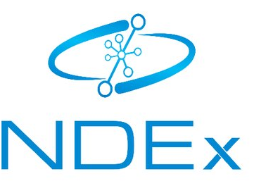
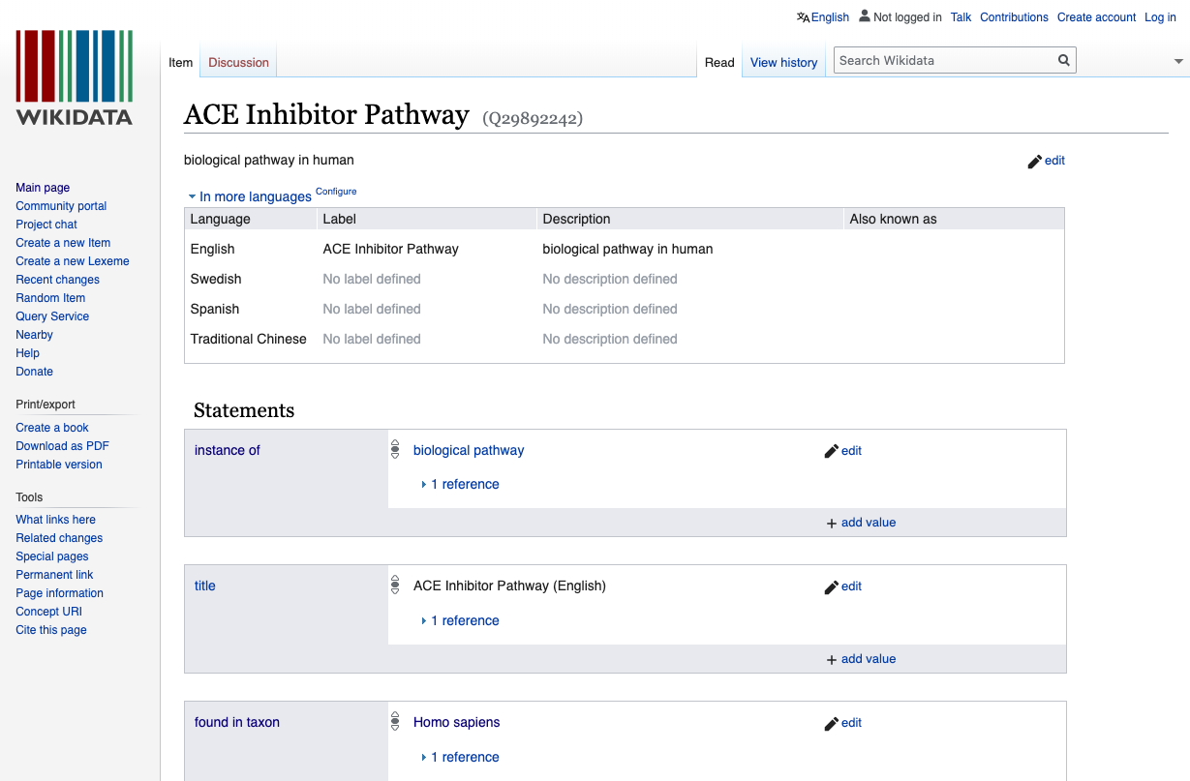
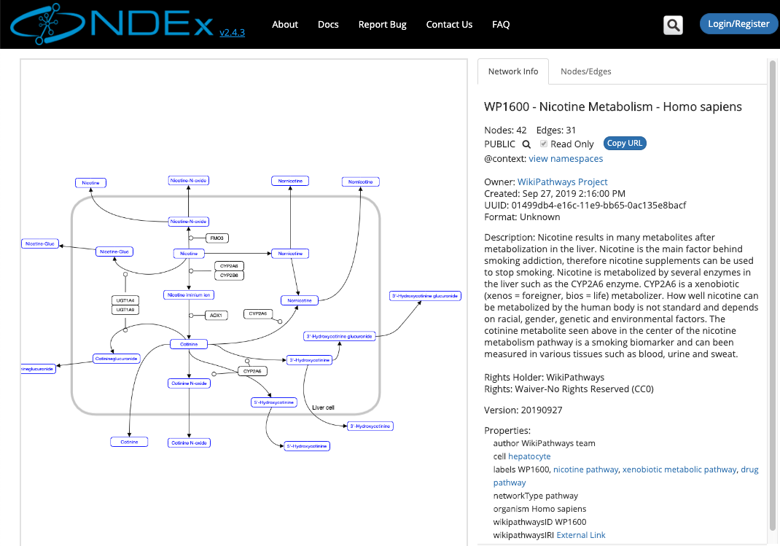
Publishing Pathway Models
RDF
Bioinformaticians
External tools
Web services
WikiPathways

Slide 10
Overview
Introduction to Pathways in Research
Guided Tour of Editing Tools
Quality Control for WikiPathways
Hands-on Session 1: Introduction
Break
Hands-on Session 2: Create Your Own Pathway

Slide 11
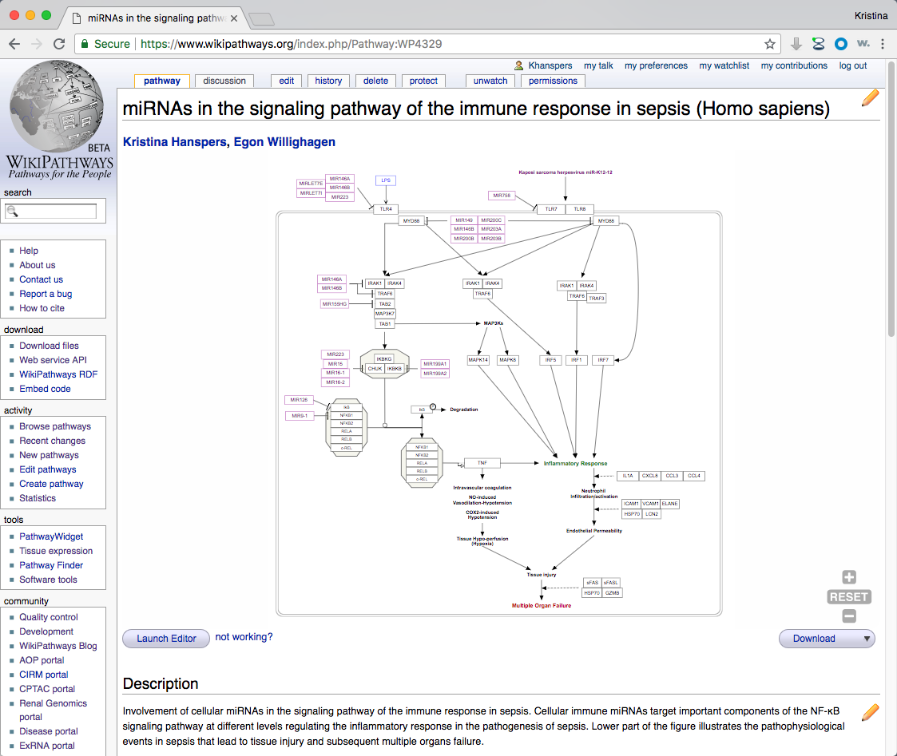
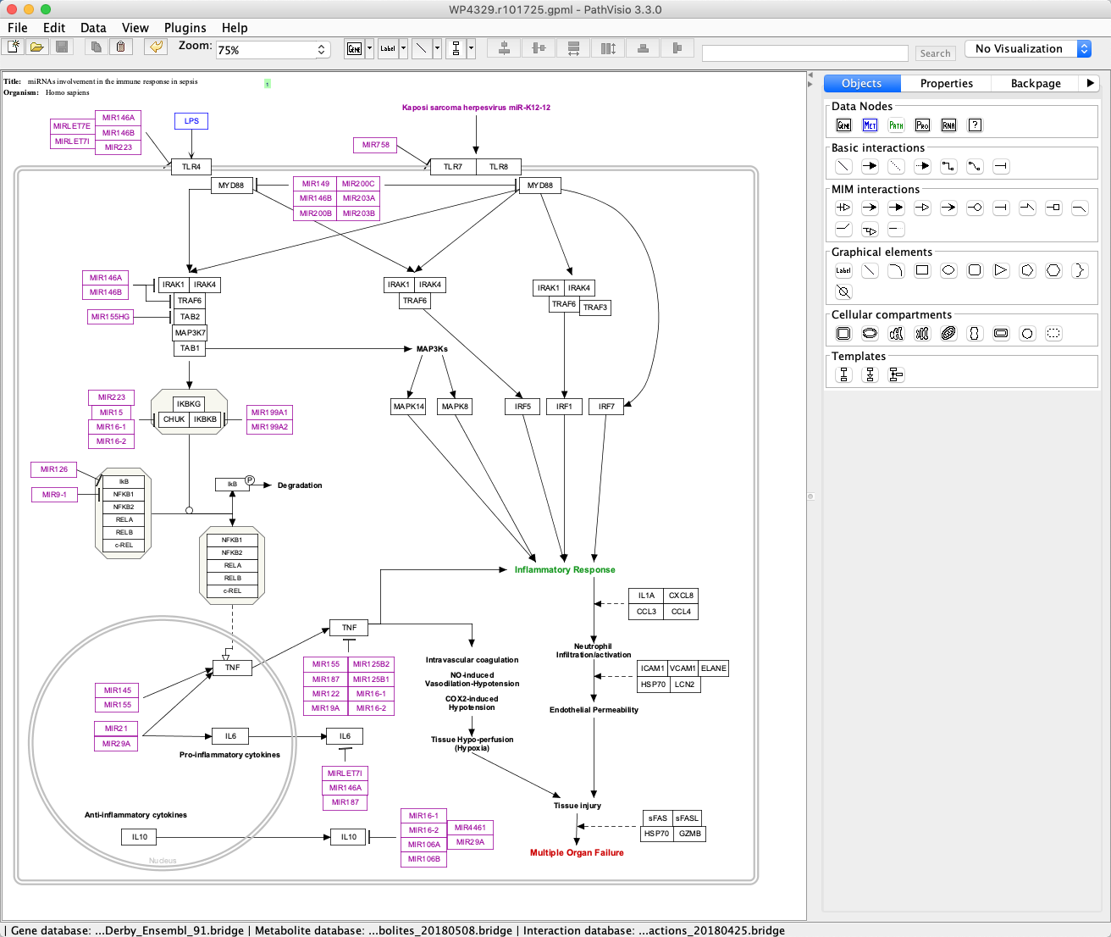
Editing Tools: WikiPathways and PathVisio
www.wikipathways.org
PathVisio Desktop Software

Slide 12
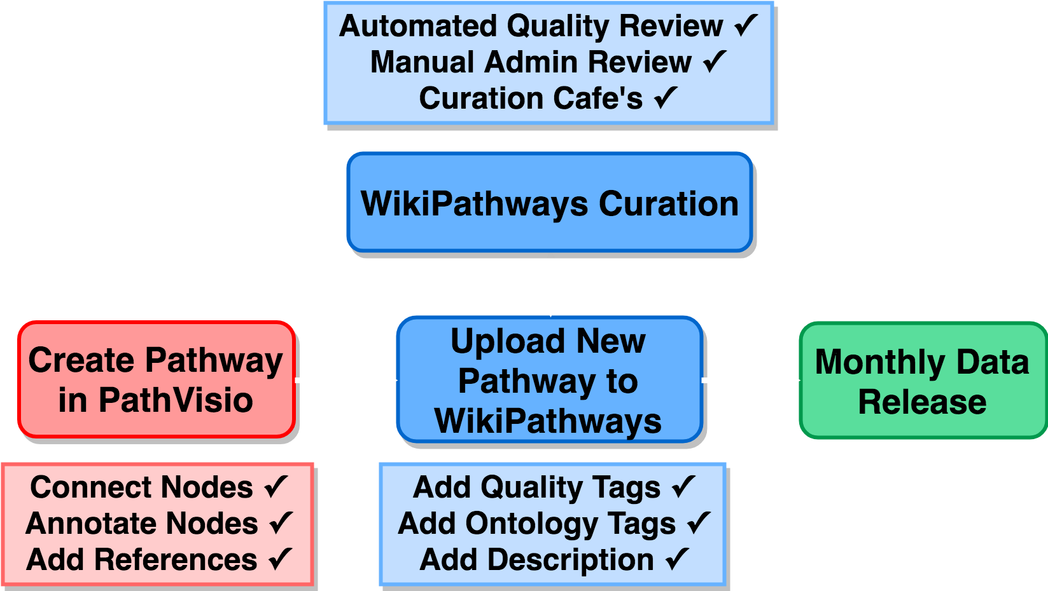
Life Cycle of a Pathway Model at WikiPathways
WikiPathways QA

Slide 13
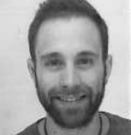

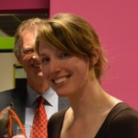

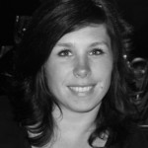


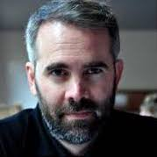
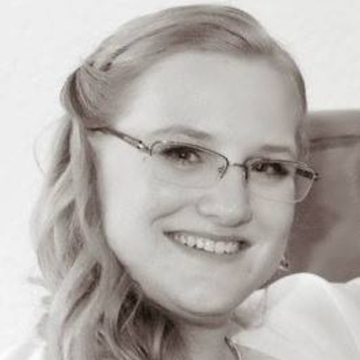
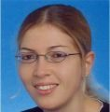

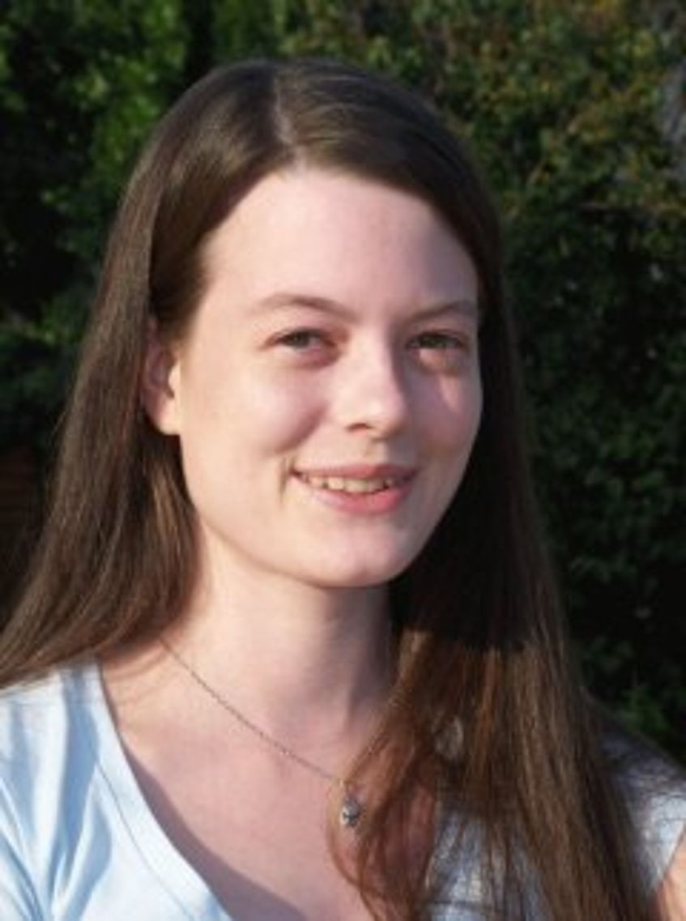

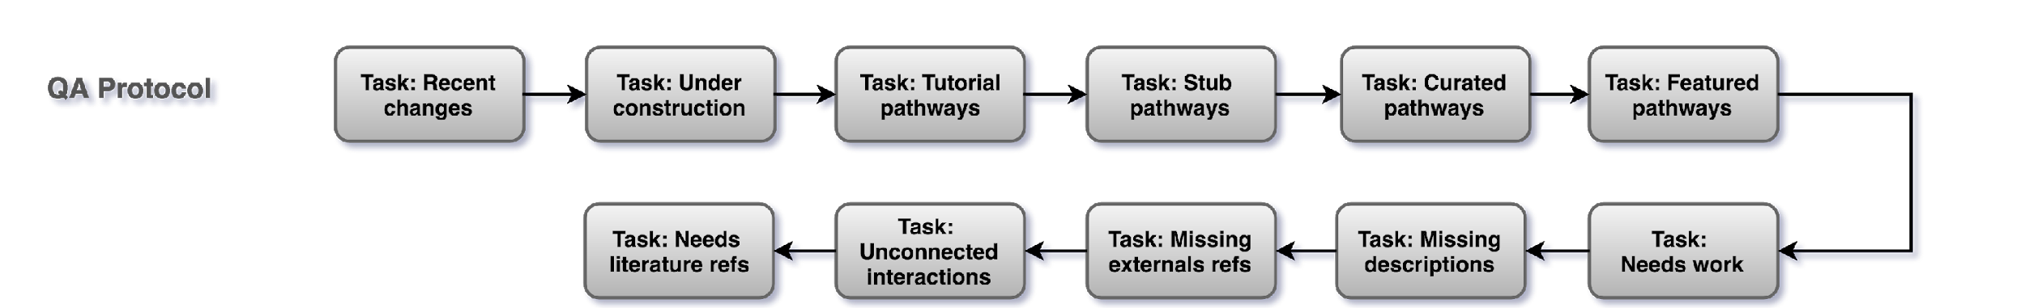
Quality Control Protocol
QA Team
https://wikipathways.github.io/academy/qaprotocol.html

Slide 14
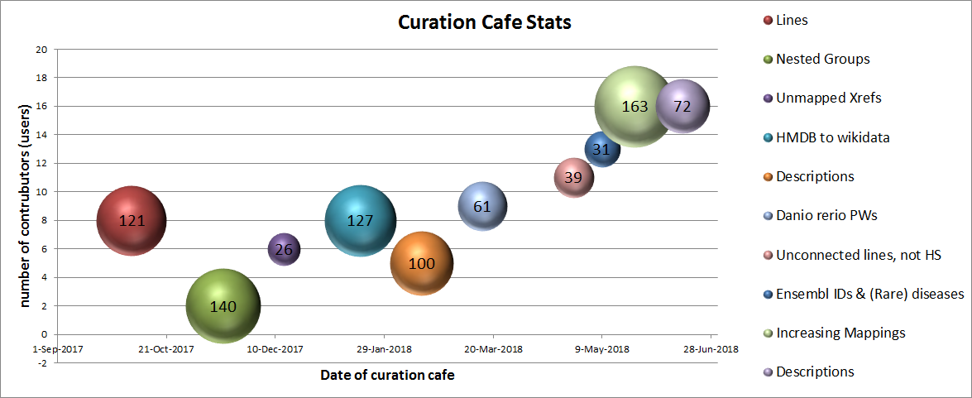
Focused QA Events

Slide 15
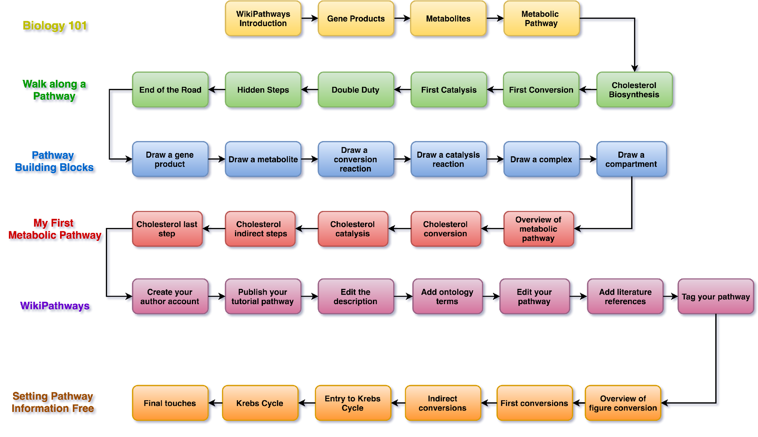
WikiPathways Academy
academy.wikipathways.org

Slide 16
Overview
Introduction to Pathways in Research
Guided Tour of Editing Tools
Quality Control for WikiPathways
Hands-on Session 1: Introduction
Break
Hands-on Session 2: Create Your Own Pathway

Slide 17
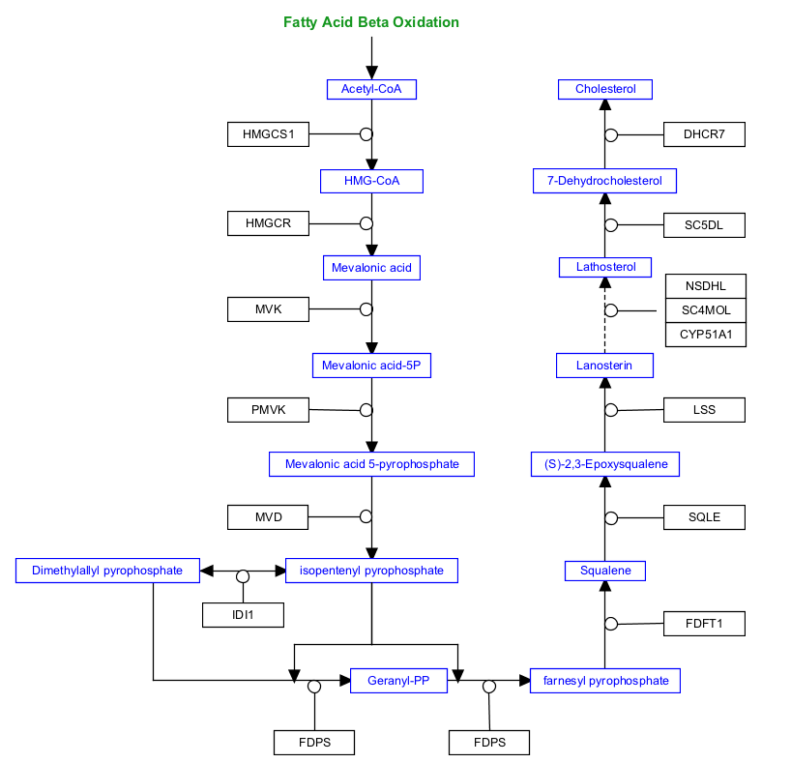
Drawing Challenge 1: Cholesterol Biosynthesis

Slide 18
Overview
Introduction to Pathways in Research
Guided Tour of Editing Tools
Quality Control for WikiPathways
Hands-on Session 1: Introduction
Break
Hands-on Session 2: Create Your Own Pathway

Slide 19
Pathway Curation
Identify a pathway topic
Find a model / use your own
Search WikiPathways
Make a curation plan!
Edit existing
Clone and mutate
New pathway

Slide 20
What’s the difference between you and a pathway curator?
NOTHING!

Slide 22
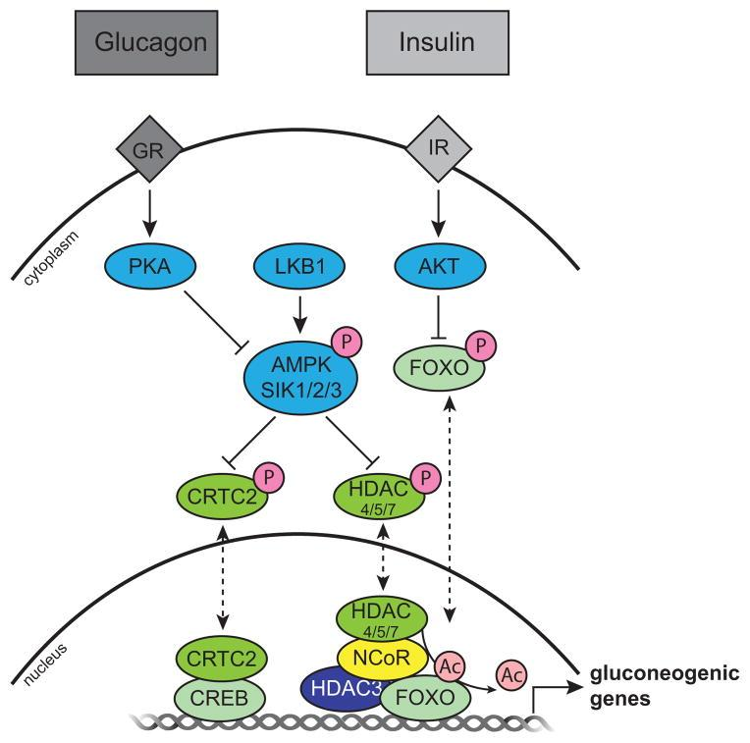
Example pathway 1: Kinase-mediated control of CRTC2 and HDAC4/5/7 subcellular localization and activity
Transcriptional coregulators: fine-tuning metabolism. Mouchiroud et al, Cell Metab, 2014, Figure 4.
PMID: 24794975
Molecular model of kinase-mediated control of CRTC2 and HDAC4/5/7 subcellular localization and activity
The metabolic hormones glucagon and insulin signal through the glucagon receptor (GR) and insulin receptor (IR), respectively, to initiate signaling cascades downstream of changes in metabolic status. PKA and LKB1 phosphorylate (orange circles with a P) the AMPKRs (AMPK-Related Kinases), including AMPK and SIK1/2/3 which, when active, phosphorylate CRTC2 and HDAC4/5/7, resulting in their cytoplasmic sequestration. When unphosphorylated, CRTC2 and HDAC4/5/7 translocate to the nucleus (dashed lines) where they are free to promote the activation of gluconeogenic gene expression programs through CREB and the NCoR, HDAC3, FOXO complex, respectively. CRTC2 coactivates CREB, and nuclear FOXO is activated upon HDAC4/5/7-mediated deacetylation (light pink circles). In parallel, AKT phosphorylation regulates the activity of FOXO.

Slide 23
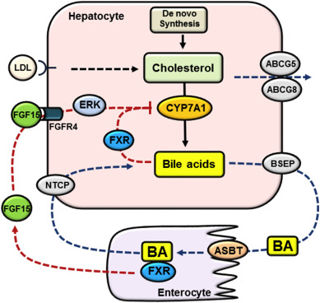
Example Pathway 2: Bile acid synthesis and enterohepatic circulation
Cholesterol and bile acid-mediated regulation of autophagy in fatty liver diseases and atherosclerosis. Wang et al, Biochim Biophys Acta Mol Cell Biol Lipids 2018, Figure 1
PMID: 29653253
Bile acid synthesis and enterohepatic circulation. Hepatocytes acquire cholesterol via de novo synthesis and receptor-mediated endocytosis of cholesterol-rich lipoproteins. Hepatocytes eliminate cholesterol via bile acid synthesis and biliary secretion of cholesterol via ABCG5/ABCG8. Bile acids are synthesized from cholesterol in hepatocytes. CYP7A1 catalyzes the first and rate-limiting step in cholesterol conversion into bile acids. Bile acids are secreted into the bile via BSEP and subsequently released into the small intestine. The majority of bile acids is re-absorbed into the enterocytes via ASBT and transported back to the liver via portal circulation. Basolateral NTCP transports conjugated bile acids into the hepatocytes. Bile acids in the hepatocytes activate FXR to inhibit CYP7A1. Bile acids in the small intestine activate FXR to induce FGF15, which binds and activates FGFR4 to inhibit CYP7A1 partially via ERK signaling.

Slide 24
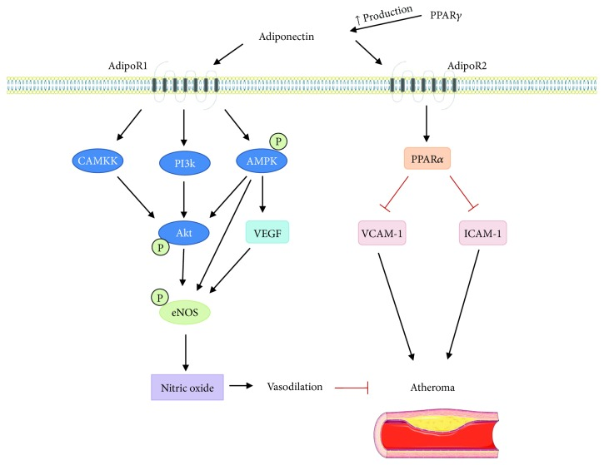
Example Pathway 3: Proposed signaling mechanisms of adiponectin in prevention of ischemic stroke
Role of Adiponectin in Central Nervous System Disorders, Boemer et al Neural Plast. 2018, Figure 2.
PMID: 30150999
Proposed signaling mechanisms of adiponectin in prevention of ischemic stroke. Signaling through AdipoR1 and AdipoR2 can reduce formation of atheroma. AdipoR1 activates the AMP-activated protein kinase (AMPK) pathway resulting in phosphorylation of protein kinase B (Akt) and activation of vascular endothelial growth factor (VEGF). Activation of Akt through calcium calmodulin kinase kinase (CAMKK), phosphatidylinositol-4,5-bisphosphate 3-kinase (PI3K), and AMPK contributes to activation of endothelial nitric oxide synthase (eNOS). Additionally, AMPK and VEGF also increase eNOS activity leading to nitric oxide (NO) production. Increase in production of NO leads to vasodilation, which is beneficial in prevention of atheroma and ischemia. Adiponectin signaling reduces vascular cell adhesion molecule 1 (VCAM-1) and intracellular adhesion molecule 1 (ICAM-1), and these adhesion molecules increase atheroma size. Peroxisome proliferator-activated receptor alpha (PPARα) also reduces VCAM-1 and ICAM-1, and PPARα is activated by AdipoR2 signaling. PPARγ increases production of adiponectin and also leads to reduction of VCAM-1 and ICAM-1. This figure was produced using Servier Medical Art (http://www.servier.com/).

Slide 25
Questions?
kristina.hanspers@gladstone.ucsf.edu

